Slide 1

Dr. Ammar Haider
Assistant Professor
School of Computing
CS3002 Information Security
IT Security Management

Slide 2
Security Management
So far in this course we have learnt a range of technical and administrative measures that can be used to manage and improve the security of information systems.
But we need a process of selecting best measures and implementing them to meet an organization’s security need.
This involves examining three questions:
What assets do we need to protect?
How are those assets threatened?
What can we do to counter those threats?
IT security management is the formal process of answering these questions

Slide 3
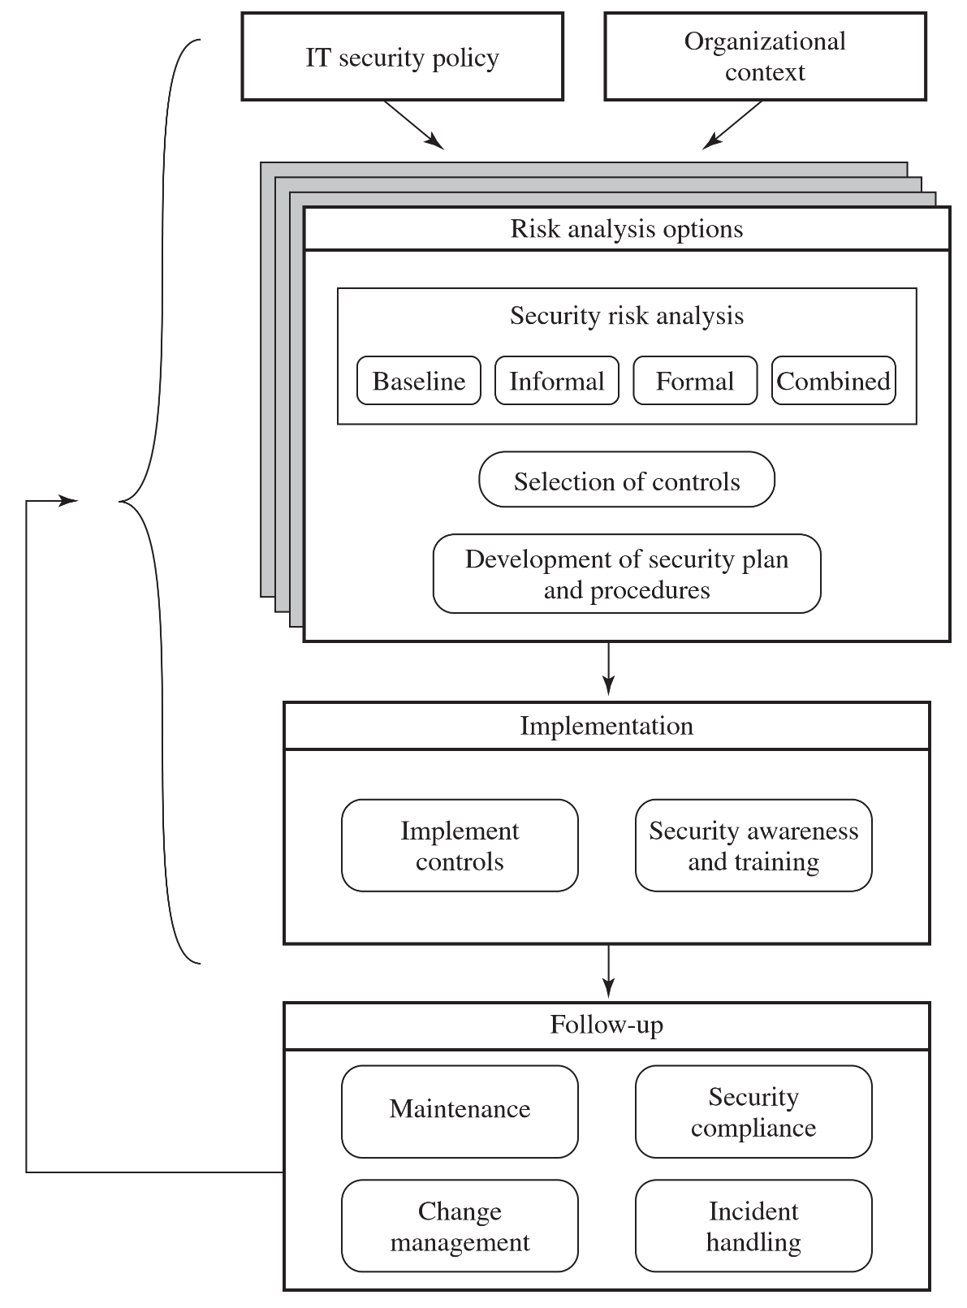
Overview of security management processes
Figure adapted from ISO 27000 series standards

Slide 4
Security Policy
Organizational security policy describes what the objectives and strategies are and the process used to achieve them.
It may be either a single large document or, more commonly, a set of related documents.
It needs to address the following topics
Scope and purpose of the policy
Relationship of the security objectives to the organization’s business objectives, and any legal and regulatory obligations

Slide 5
Security Policy
IT security requirements in terms of confidentiality, integrity, availability, accountability, authenticity, and reliability.
Assignment of IT security management responsibilities to company roles
e.g. Senior team leader is responsible for so and so.
Risk management approach adopted
baseline, informal, detailed, or combined (‘detailed’ approach is briefly covered later in this lecture)
How security awareness and training is to be handled
Any legal sanctions that may be imposed on staff, and the conditions under which such penalties apply

Slide 6
Security Policy
Integration of security into systems development and procurement
how security will be incorporated when designing in-house software, and when buying new software
Definition of the information classification scheme used across the organization
i.e. define the terms top secret, confidential, restricted etc.
Contingency and business continuity planning
Incident detection and handling processes
How and when this policy should be reviewed
The method for controlling changes to this policy

Slide 7
Security Policy
Note: some sources call these kind of documents security plan
Policy is subject to periodic review and revision as the organization’s security needs change.
Various standards recommend that overall responsibility for the organization’s IT security be assigned to a single person, the organizational IT security officer.

Slide 8
Organizational Context
At a high level, all organizations have same security goal: to prevent security breaches. But digging deeper, security needs for each organization differ.
What does an organization consider its most precious asset?
A pharmaceutical company might value its scientific research on new drugs and its sales and marketing strategy as its most important assets.
A hospital would likely find protecting the confidentiality of its patients’ records most crucial, perhaps followed closely by the integrity and availability of its systems that implement patient care (like vitals monitoring systems)
A television studio could decide its archive of previous broadcasts is most important.

Slide 9
Risk Management

Slide 10
Why risk management
An organization can’t protect everything equally.
Their resources—time, money, and people—are finite. So they must focus their defenses on what matters most.
Cybersecurity Risk Management is the process of identifying what is most valuable and most vulnerable, and then making strategic decisions to protect it.
It’s about being smart, not just strong.

Slide 11
Elements of risk assessment
Risk assessment is formal process to understand your specific cyber risks. It answers three key questions:
What are our most important assets? the “crown jewels” — e.g., customer database, industrial control systems, financial records.
What are the threats and vulnerabilities that could affect those assets?
What would be the impact if something bad happened?
Note that a business should consider all kinds of risks during their assessment, not just IT security issues.
Here we are only focusing on the latter.

Slide 12
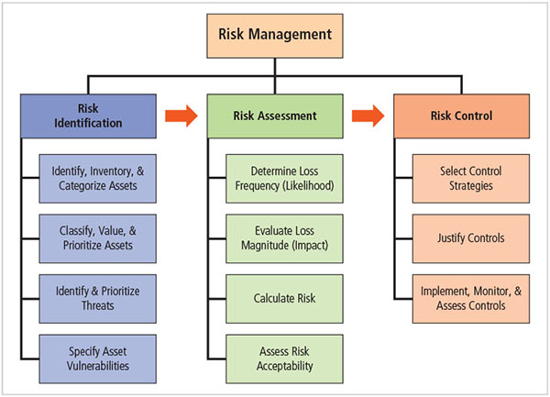
Risk Management

Slide 13
Identifying Assets
Assets can be grouped into few categories.
Hardware: servers, client workstations, printers, portable devices, network equipment (routers, switches) etc.
Software: source code, binary executables, operating systems, systems software (compiler etc.), maintenance and diagnostic software
Data: data in memory, on permanent media, in cloud, printed data, audit logs
People: skilled staff needed to run the systems
Supplies: paper, data storage devices, printer ink, electricity, heating and cooling, necessary buildings

Slide 14
Identifying Assets
Documentation: on programs, hardware, systems, administrative procedures, and the entire system
Reputation: company image, goodwill with customers and business partners
Availability: ability to do business, ability to resume business rapidly and efficiently after an incident
You must tailor this list to your own situation. No two organizations will have the same assets to protect, and something that is valued by one organization may not have the same value to another.

Slide 15
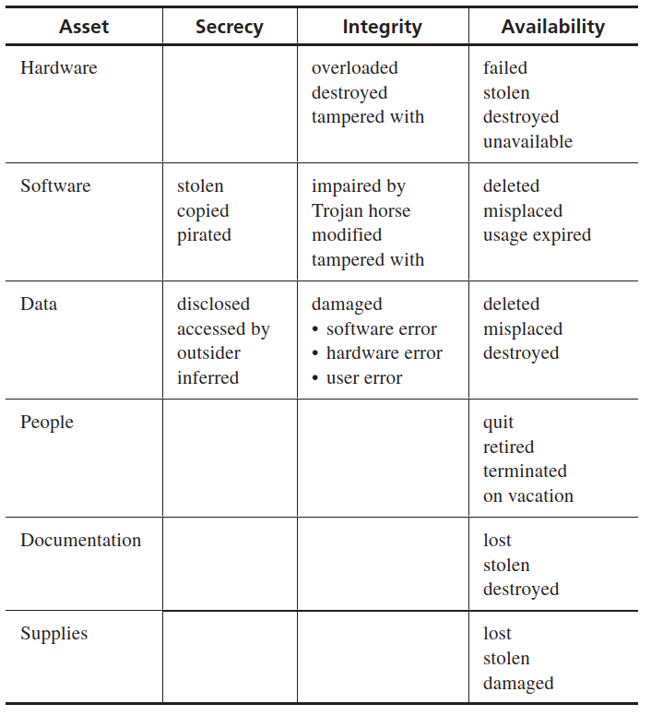
Identify Threats to Assets
Threats can also be grouped in a several categories
Each type of asset is subject to different type of threats
Note: this table only shows TYPES of assets and threats.
An organization will make list of actual assets and their corresponding actual threats

Slide 16
Risk Likelihood
Likelihood indicates the chances that the organization will have to face a specific threat
Could be expressed either
on a qualitative scale like low, moderate high
or
as a probability number between 0 and 1. Unfortunately, it is often extremely hard to determine accurate probabilities
Can be estimated from organization’s history or published studies

Slide 17
Loss Magnitude (Impact)
How much is the effect on organization’s business when threat occurs
Again, can be expressed either way
qualitatively as low, moderate, high or as a number on an arbitrary scale (say 1–10)
quantitatively as actual financial loss measured in monetary value. e.g. $20,000 revenue loss due to downtime of 5 minutes. But in many cases, exact loss figure is also very hard to estimate.

Slide 18
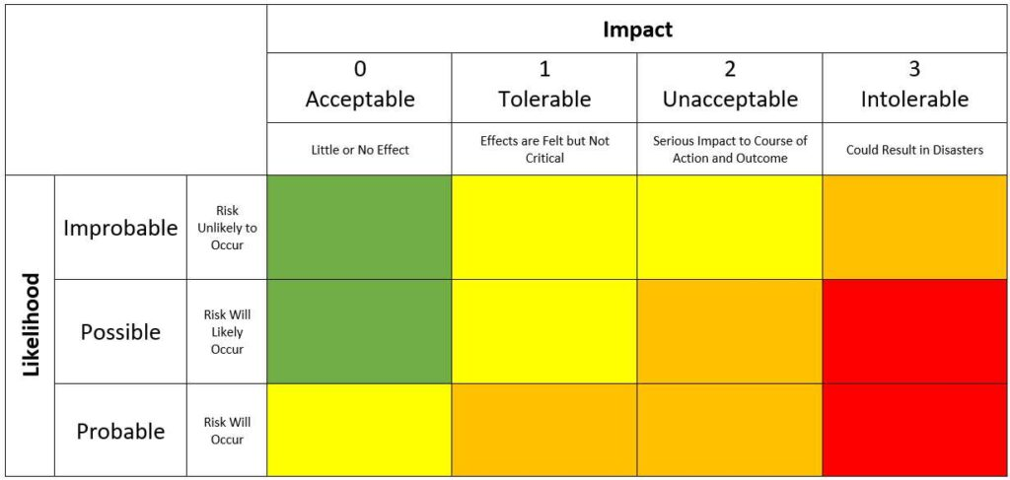
Calculate Risk Score
Risk score = Likelihood of threat × Threat impact
Score gives us a measure of prioritizing the risks.
Risk matrix (aka risk register) is a tool for visualizing all risks. Focus your resources on the red zone first!

Slide 19
Risk Treatment (Controls)
Once all the threats and their scores have been documented, its time to decide what are we going to do about each.
There are four control strategies
Transference
Acceptance
Avoidance
Defense / Mitigation

Slide 20
Transference
Shift risk to other assets, processes, or organizations
Examples
Outsourcing site hosting to a cloud service provider
Purchasing insurance against ransomware attacks
Signing service contracts with a vendor
Concentrate on what you do best

Slide 21
Acceptance
Understand the consequences and do nothing to protect a vulnerability
Accept the outcome of its exploitation
Valid only when the particular function, service, information, or asset does not justify the cost of protection
‘Risk appetite’ describes the degree to which organization is willing to accept risk as trade-off to the expense of applying controls

Slide 22
Avoidance
Avoid business activities that introduce an uncontrollable risk
This usually results in loss of convenience or inability to perform some useful function.
The loss of this capability is traded off against the reduced risk profile.
Example
A personal finance & budgeting app decides not to integrate with users’ bank accounts – due to risk of unauthorized transactions if app is hacked.

Slide 23
Defense / Mitigation
Apply safeguards that either
reduce the likelihood of threat occurrence
or
lessen the impact should the vulnerability be exploited.
Mitigation will reduce the risk score to a smaller value (called ‘residual risk’)
Examples
Regularly update software to remove vulnerabilities
Enforce access control on files and databases
Set up an intrusion detection systems

Slide 24
Contingency Planning

Slide 25
When bad things do happen
No defense is 100% perfect. A security incident will eventually occur.
Our goal should be to minimize the damage and recover as quickly as possible.
Failing to plan is planning to fail.
Incident response plan tells the staff how to deal with a security incident.
It covers identification and classification of an incident and appropriate response to it.
Incident response (IR) is more reactive, than proactive, except for planning that must occur to prepare IR teams to be ready to react to an incident

Slide 26
Incident Response Planning
Attacks classified as incidents if they:
are directed against information assets
have a realistic chance of success
could threaten confidentiality, integrity, or availability of information resources
In planning, we develop a series of predefined responses
Set of activities taken to detect and correct the impact
Enables organization to react quickly and correctly instead of everyone being confused in heat of the moment.

Slide 27
Incident Response Plans (IRP)
IRP documents define the actions of each person (role) who must help the organization react to and recover from the incident.
The documents list
Who is on the Incident Response Team? (IT, Legal, HR, Communications, Leadership).
Who has the authority to make critical decisions? (e.g., shutting down a system).
How do you communicate internally and externally? (To employees, the public, and regulators).
IRPs must also be tested in (say) a simulated scenario to ensure they are effective.

Slide 28
Incident Detection
Sources of Incident detection – intrusion detection systems, anti malware software, system administrators, end users.
Possible indicators: Presence of unfamiliar files, execution of unknown processes, unusual consumption of resources, unusual system crashes
Probable indicators: Activities at unexpected times, presence of new accounts, reported attacks, notification from IDS
Definite indicators: Use of dormant accounts, changes to logs, presence of hacker tools, notification by hackers

Slide 29
Incident Reaction
Once IRP is activated, the designated staff must follow the actions outlined in it.
Purpose is to
Stop the incident
Mitigate the impact
Provide information recovery
Immediately when incident is discovered, we must notify the key personnel (as specified in the IRP)
Documenting the incident is also an important action: note down the who, what, when, where, why, and how of the events
Next step is to contain the incident

Slide 30
Incident Containment Strategies
Sever affected communication circuits if possible
keeping disruption to business activities minimum
Disable accounts
Reconfigure firewall
Disable process or service
Take down email
Isolate affected channels, processes, services, or computers
Most drastic: Stop all computers and network devices

Slide 31
Incident Recovery
Assess full extant of the damage
Conduct ‘forensic’ activities to determine how the incident occurred and what happened.
Based on results of forensic analysis
Identify and resolve vulnerabilities
Address safeguards
Evaluate monitoring capabilities
Restore data from backups
Restore process and services
Continuously monitor system

Slide 32
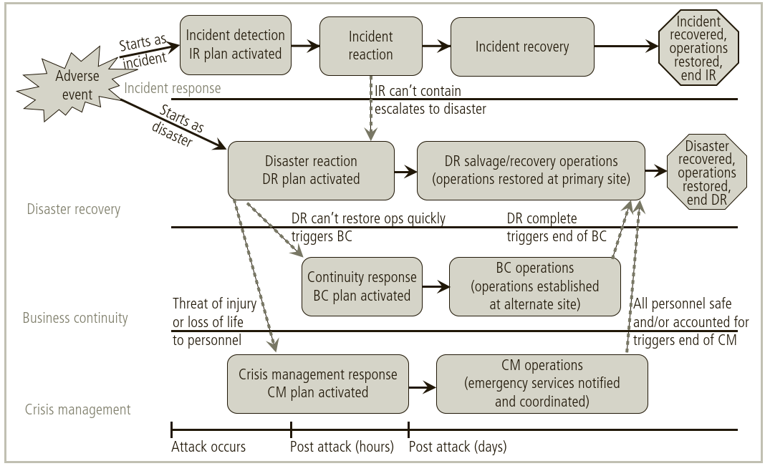
Contingency Planning Timeline

Slide 33
Disaster Recovery Plan (DRP)
An event can be categorized as a disaster when an organization is unable to mitigate the impact of an incident while it is occurring and the level of damage or destruction is so severe that the organization is unable to recover quickly.
The Disaster Recovery Plan is similar in structure to the IR plan, provides detailed guidance in the event of a disaster.
It is organized by the type or nature of the disaster, and it specifies recovery procedures during and after each type of disaster.

Slide 34
Disaster Recovery Plan (DRP)
Aim: Secure most valuable assets, at the risk of short-term disruption.
What it contains
Clear establishment of priorities
e.g. human life is most important
After that, note down which services are most important to safeguard
Clear delegation of roles & responsibilities
Document disaster events
Mitigate impact if possible
Evacuation of physical assets

Slide 35
Business Continuity Plan (BCP)
Aim: reestablish or relocate critical business operations during a disaster
If a disaster has rendered the primary location unusable, a plan must be in place to allow the business to continue to function at an alternate location (if possible).
What it contains
The most critical hardware/software to be restored on- or off-site
Retrieving backups
Personnel responsible for each action

Slide 36
References
Stalling SPP chap 14, 15
Whitman chap. 4
Pfleeger, Security in Computing, chap 10

